Slide 1
Cyclistic case study
How do annual members and casual riders use Cyclistic bikes differently?

Slide 2
01
Mission Statement
a brief description of this project/task
02
Bibliography, Citations, and References
citing for all data sources, software and tools used for the project and analysis
03
Project/Task outline
outline of the observations noted during the analysis
CONTENTS
04
Members use the bikes far more often
Observation #1 - 2 slides
05
Members use the bikes for shorter trips
Observation #2 - 3 slides
06
Members use the bikes more on weekdays
Observation #3 - 2 slides
07
Members use the bikes more consistently
Observation #4 - 2 slides
08
Conclusions and Recap
a recap of the 4 observations - 2 slides
09
Takeaways & Suggestions
Observations regarding the available data nd suggestion on how to improve for future analysis

Slide 3
Bibliography, Citations, and References
Data source: we are using a public dataset provided by Motivate International Inc. under this license. The data is for Q1-4 of 2019 and Q1 of 2020
Power Point presentation template: obtained from Slide Members and is licensed as free for personal and commercial use. click here to view the template webpage and licensing
RStudio desktop, R and additional R packages installed: was used for the data cleaning, manipulation and creation of the visualizations (click here to see the citing of R, RStudio and all R packages used)
A.I. assistance: The author of this presentation acknowledges the use of Cody, an AI coding assistant developed by Sourcegraph, for assistance with R Code development, debugging and data visualization. Sourcegraph. (2023). Cody AI Assistant. https://sourcegraph.com/cody.
OfficeSuite Slides: Used to create the presentation deck. Version 8.90.57091.0 64-bit © 2016 - 2024 MobiSystems, Inc.
This page is to cite all data sources, software and tools used for the project and analysis

Slide 4
How do Cyclistic members use their bikes differently than non-members
The goal of this case study is to determine how Cyclistic members (referred to as "Members") use their bikes differently than non-members (referred to as "Casual").
For this case study, we are using a public dataset provided by Motivate International Inc. under this license. The data is for Q1-4 of 2019 and Q1 of 2020. This provides us with a Q1 year over year comparison as well as an entire year of bike trip data for analysis.
Prior to analyzing these datasets we have documented our cleaning and manipulation of the data including the creation of the visualizations using R programing within this RMarkdown Document.
During the analysis, we have determined the following observations:
Members use the bikes far more often than "Casual"
Members use the bikes for shorter trips in comparison to "Casual"
Members use the bikes more often on weekdays than weekends
Members use the bikes more consistently year-round than non-members

Slide 5
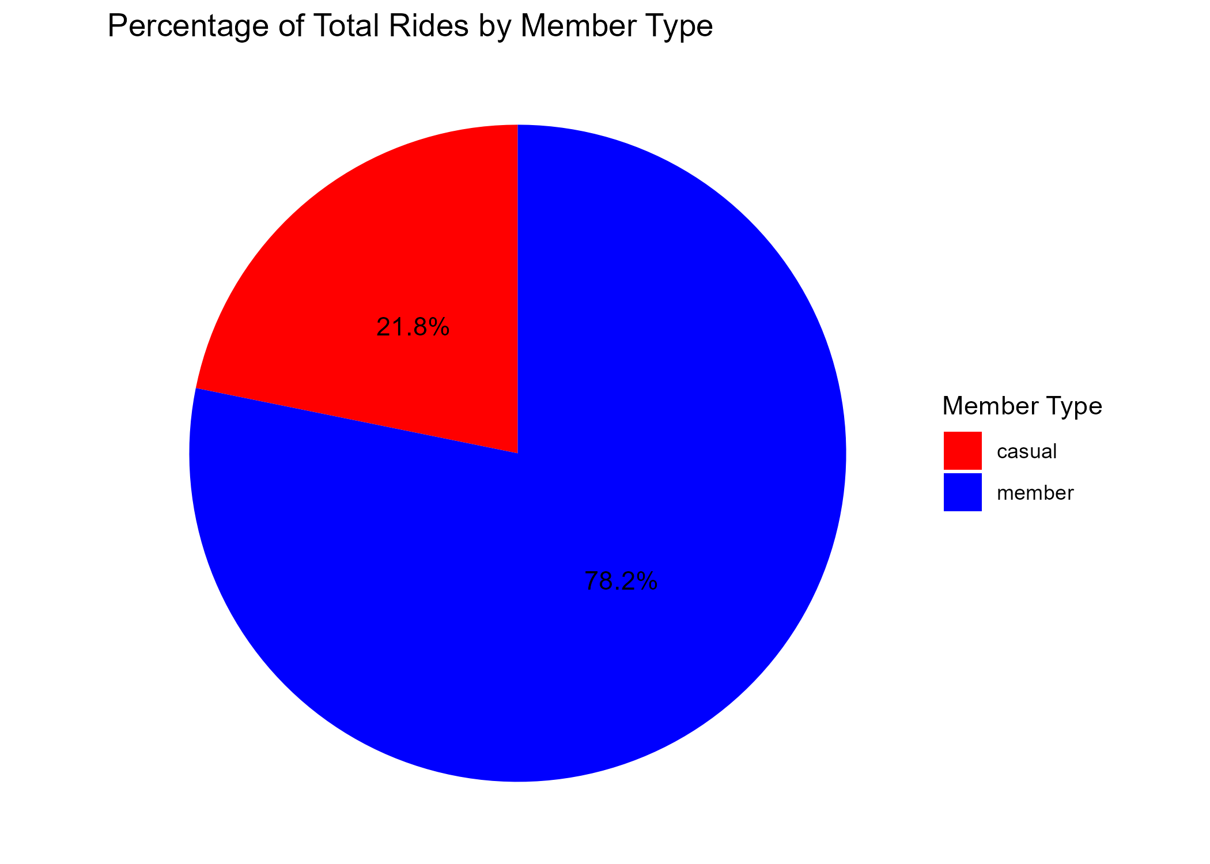
1A - Members use the bikes far more often
Here we can see the data tells us that within the timeframe of this dataset:
Members use accounts for 78.2% of all trips

Slide 6
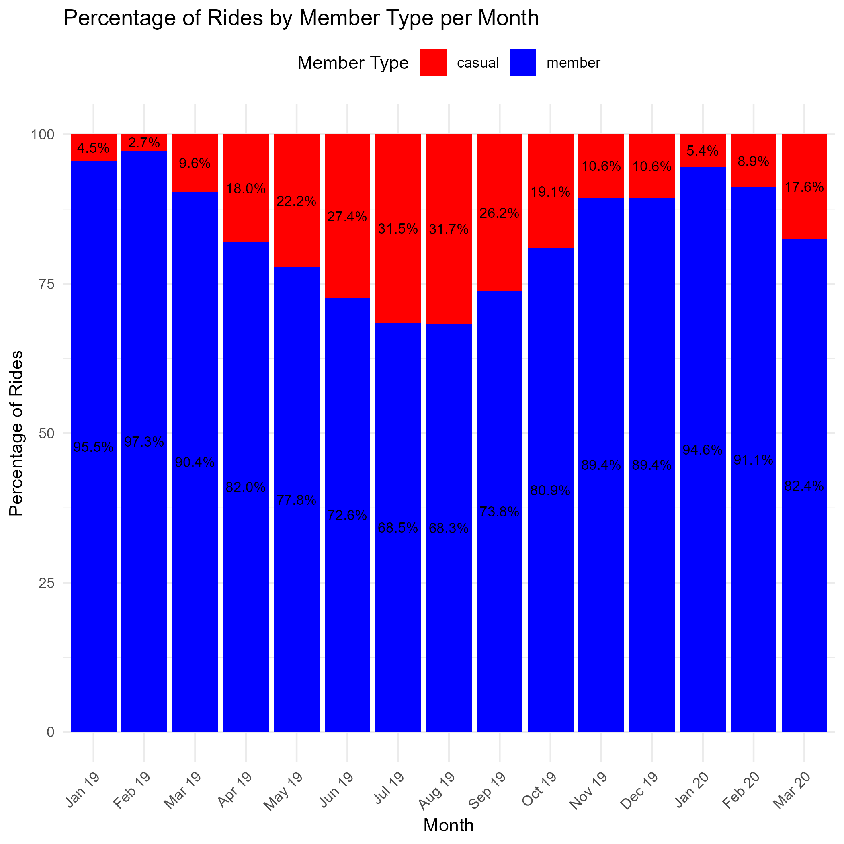
1B - Members use the bikes far more often
Here we can see the percentage split shown Month over Month.
Members consistently use the bikes more often

Slide 7
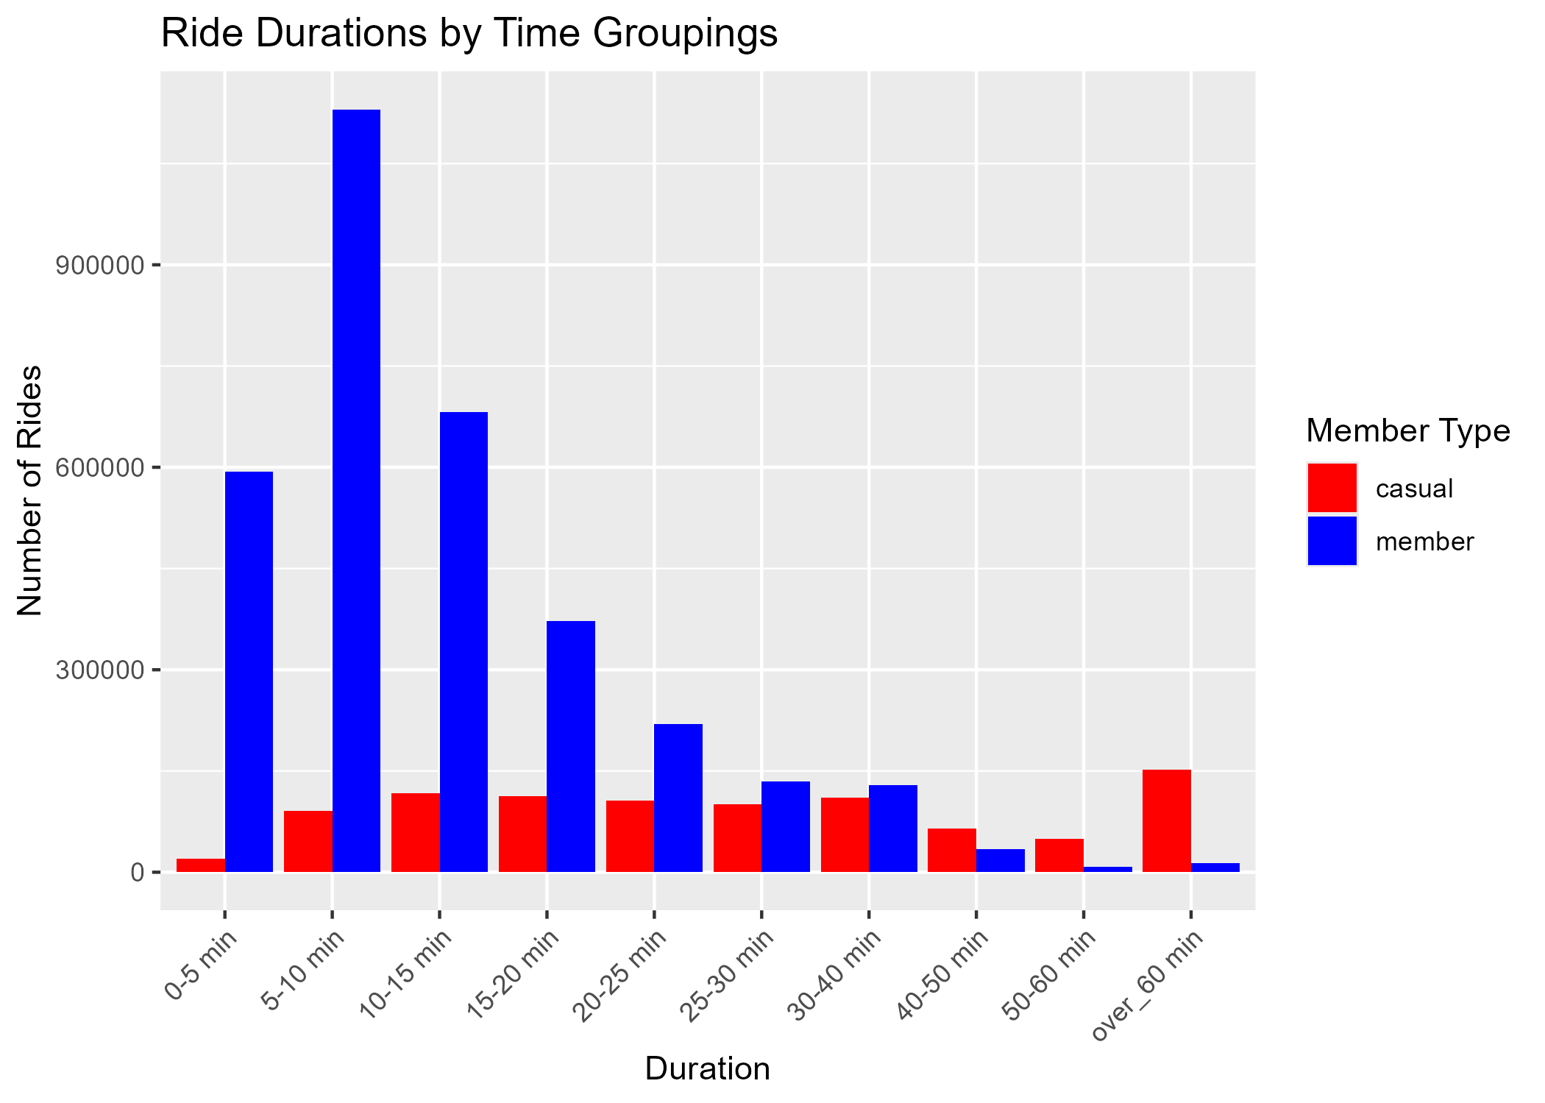
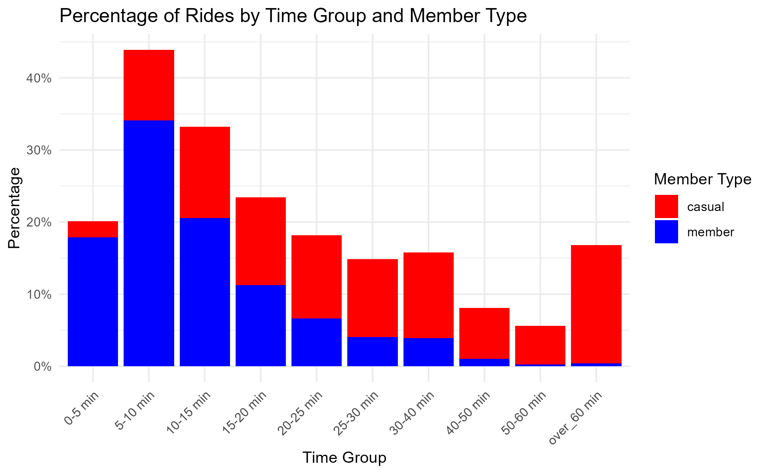
2A - Members use the bikes for shorter trips in comparison to non-members
Members use the bike for 5-10 minutes the most
Casual users use the bike for over 60 minutes the most
The majority of Member trips are less than 15 minutes

Slide 8
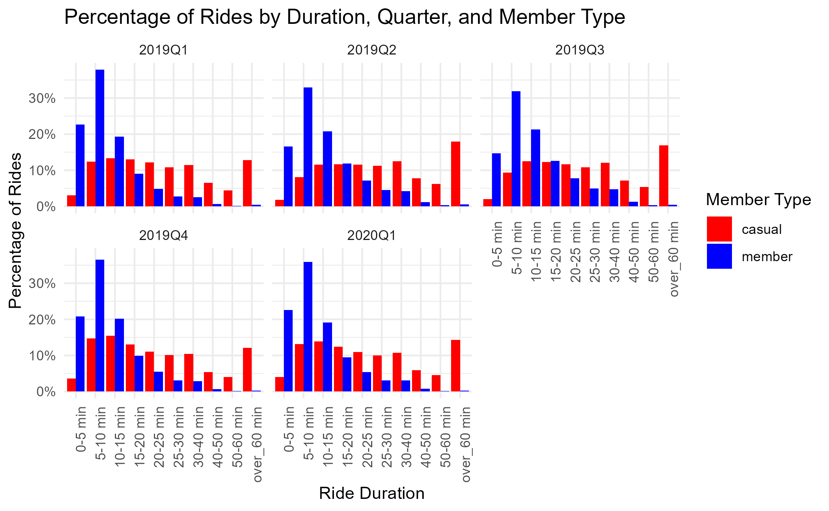
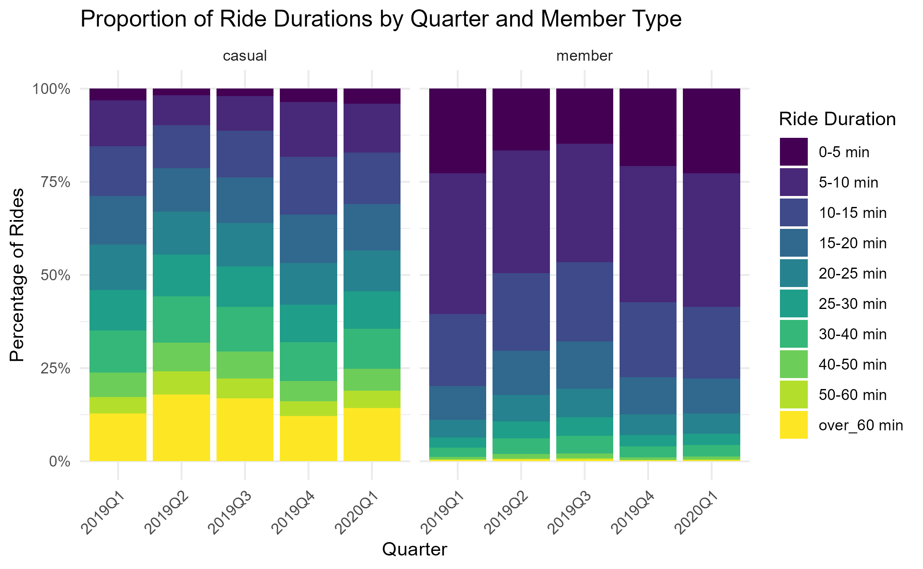
2B - Members use the bikes for shorter trips in comparison to non-members
To the left reviewing by yearly quarter we can see the consistency of the shorter ride time length for members
To the right we can see the same information represented in a heatmap

Slide 9
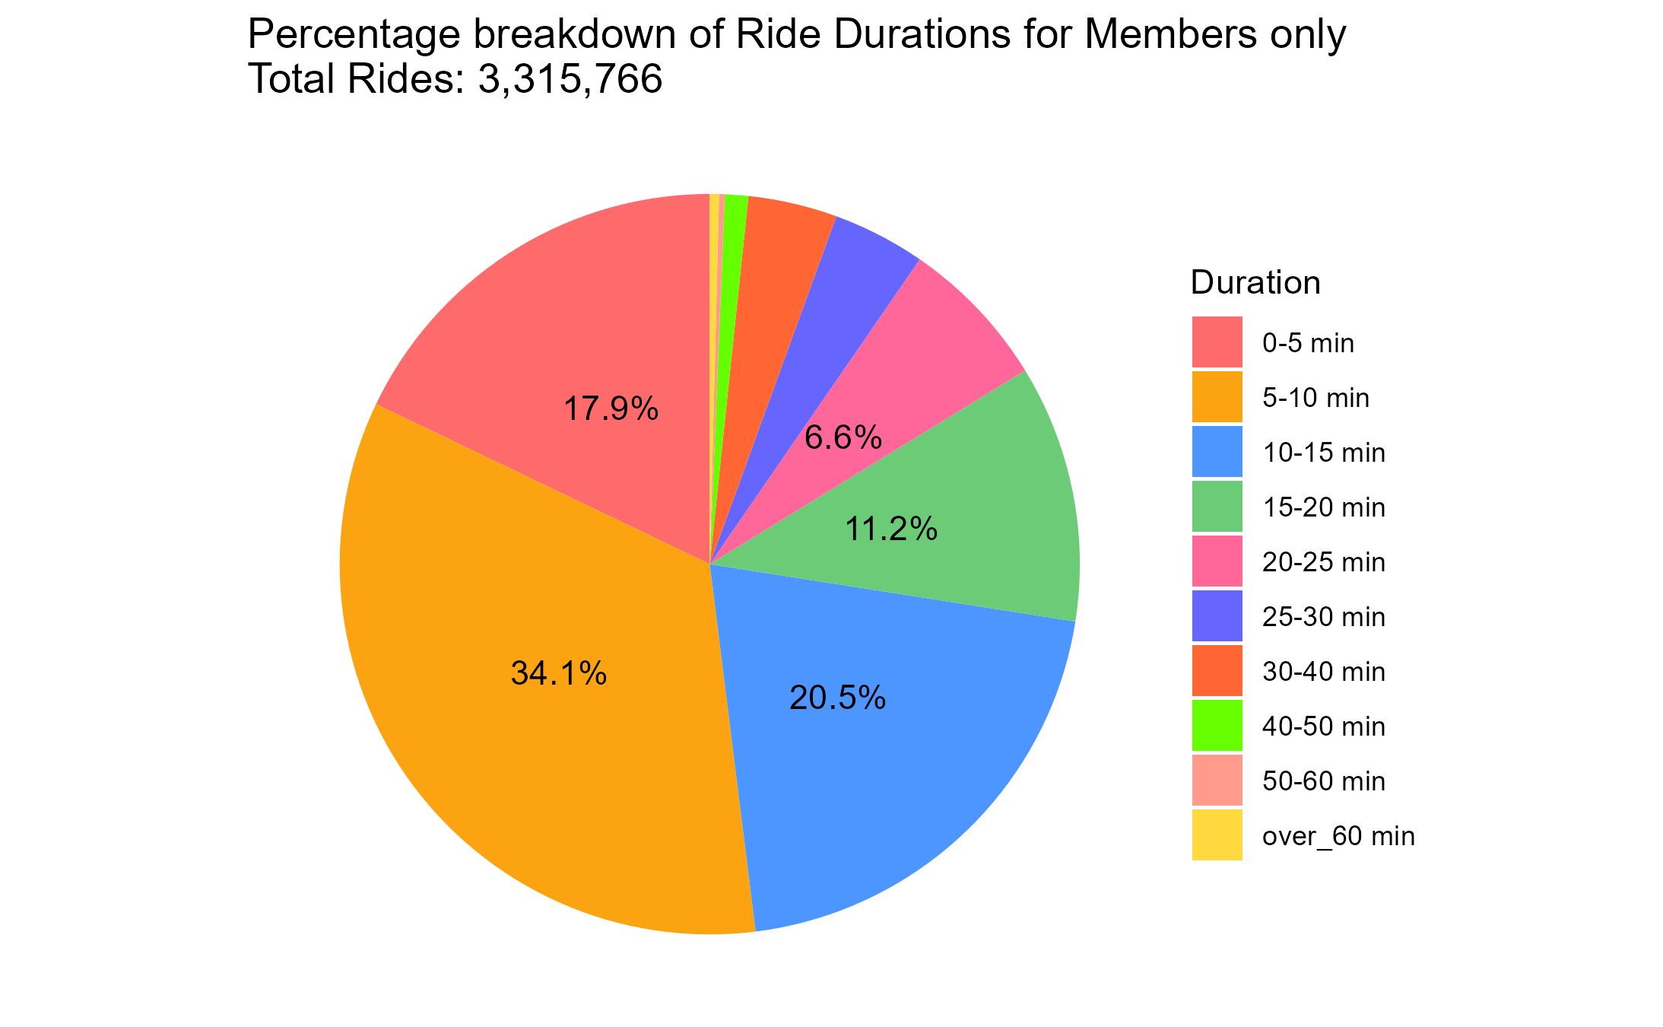
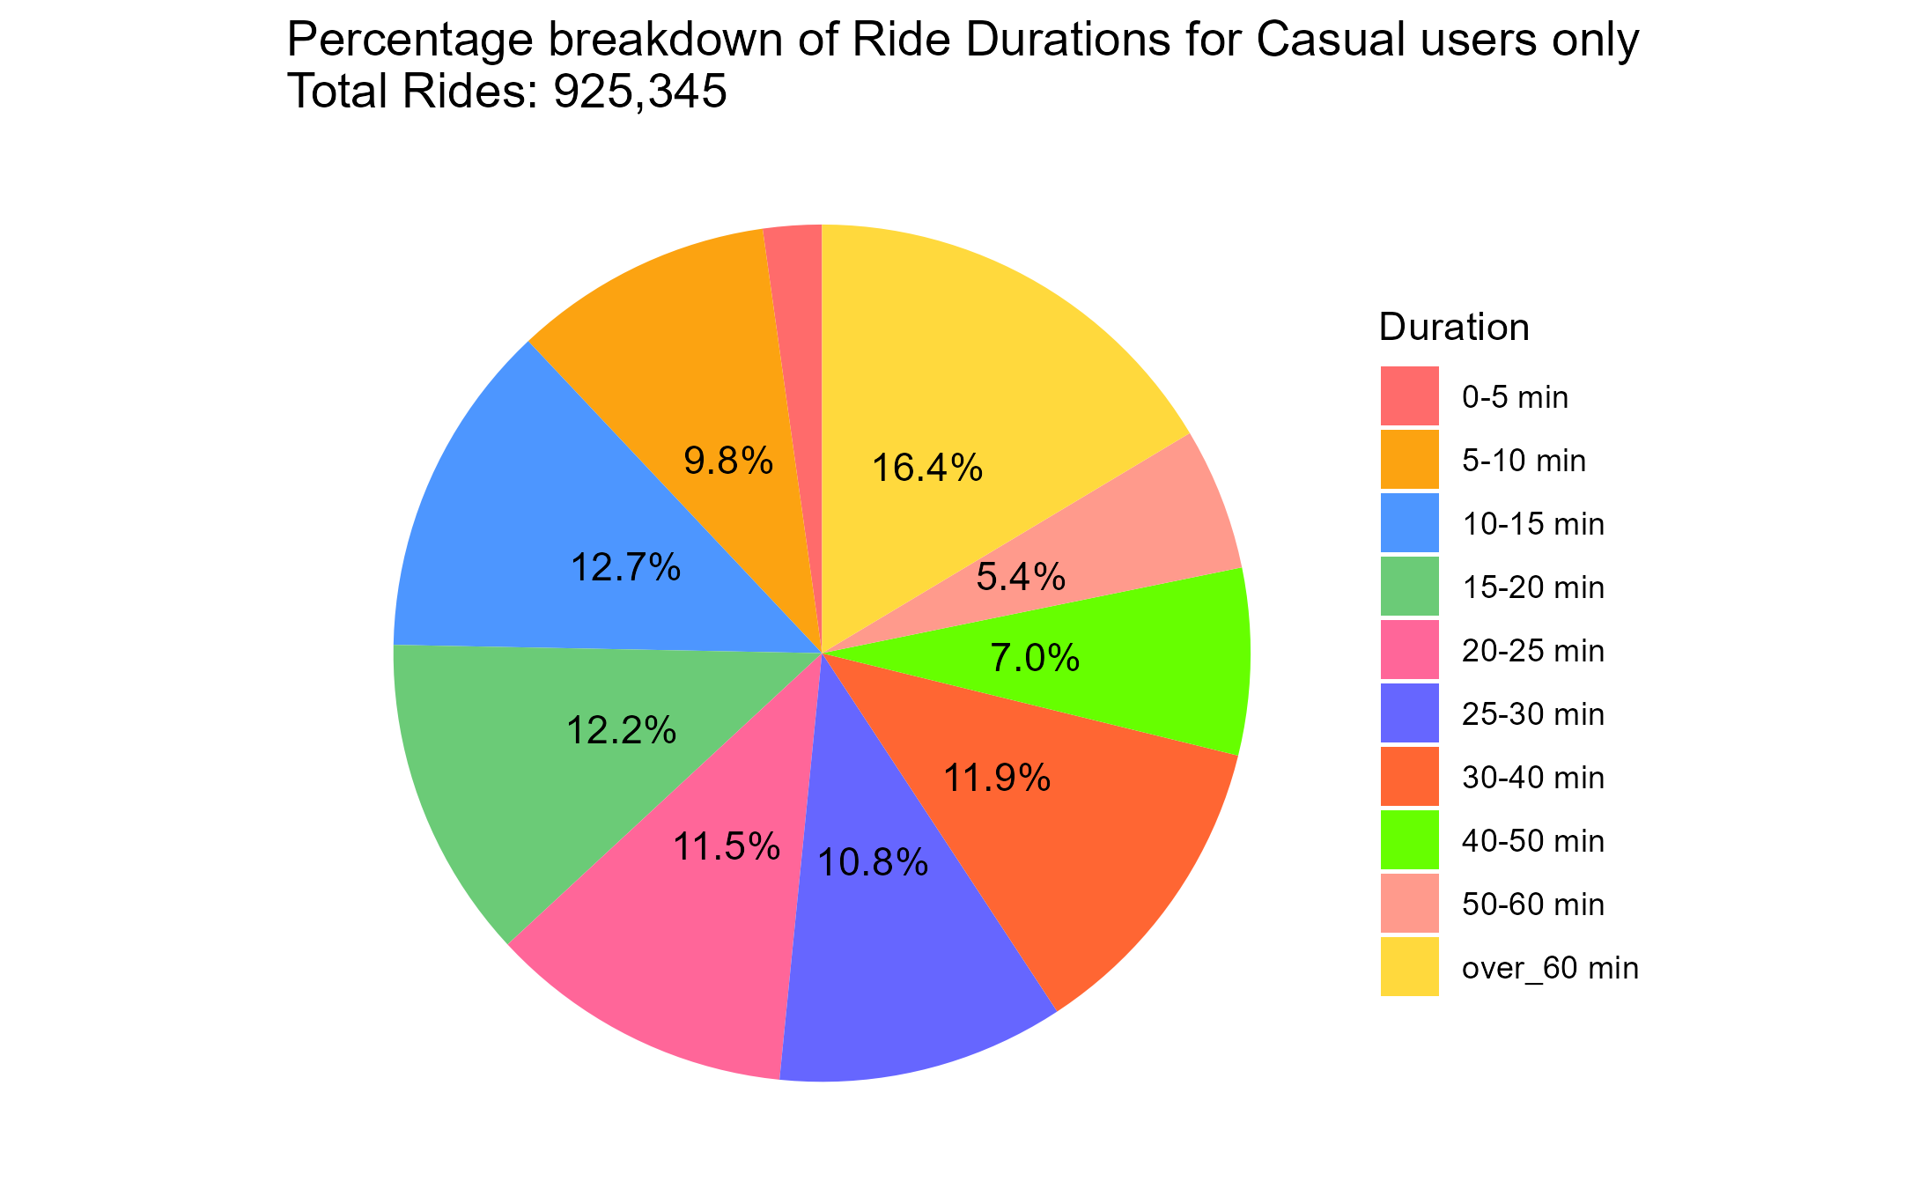
2C - Members use the bikes for shorter trips in comparison to non-members
to the left we see a
breakdown for members only.
It is clear the majority of the trips are under 15 minutes
To the right we see a breakdown
for Causal users only
the split is not as evident as it is more evenly spread throughout the timeframe chunks

Slide 10
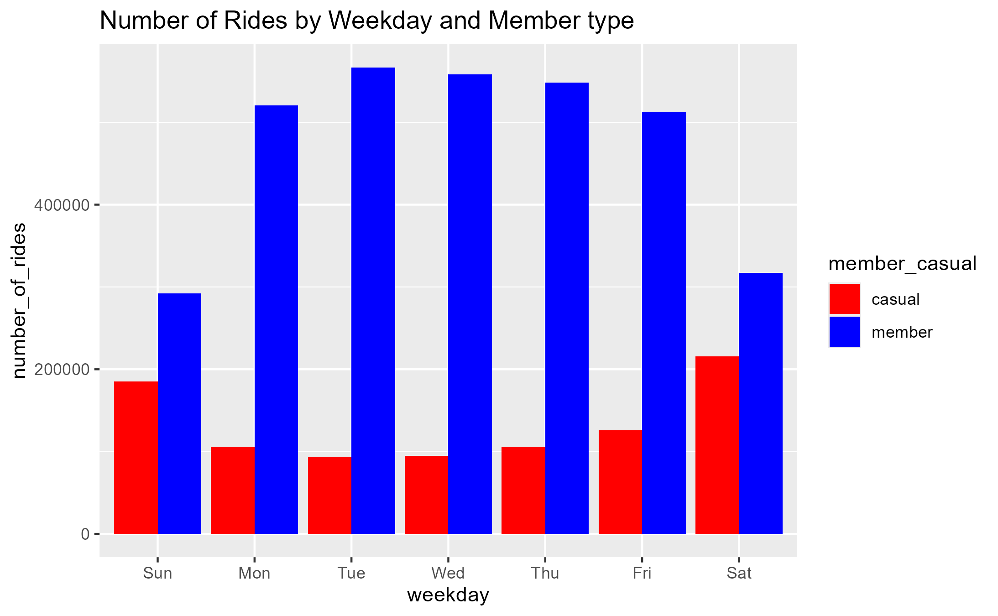
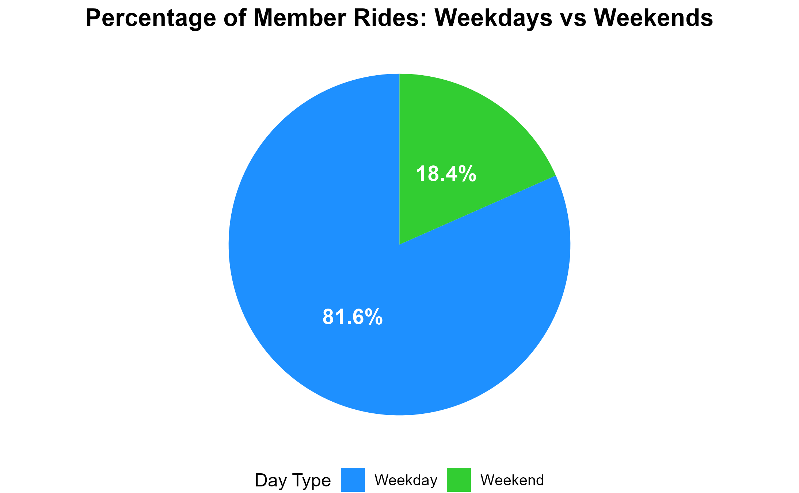
3A - Members use the bikes more often on weekdays than weekends
Members use is much higher during the work week (Mon - Fri) and lower on the weekends.
Causal use is much higher on the weekends compared to the work week
Over 80% of all Member rides are during the weekdays (Monday to Friday)

Slide 11
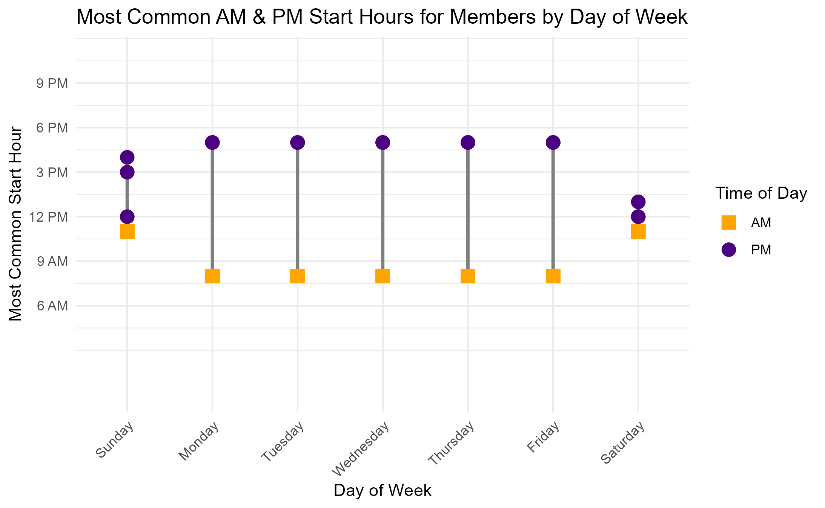
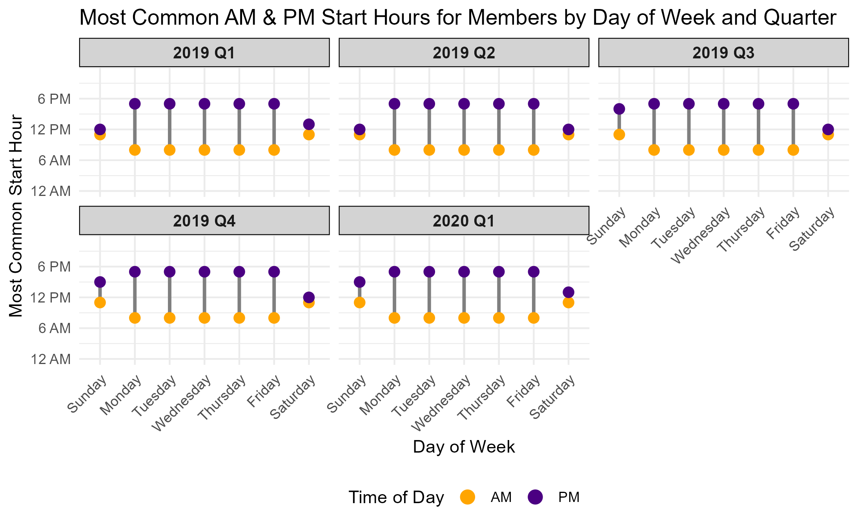
3B - Members use the bikes more often on weekdays than weekends
These visualizations = Members only
Most common AM start time = between 8-9am
Most common PM start time = between 5-6pm
The times are consistent year round in the Quarter over Quarter chart below
These charts show the most common ride start times in the morning and evening for each day of the week.
Based on the most common start times, there is a high probability that members are using the bikes as part of their commute to work, however this would require more analysis to confirm.

Slide 12
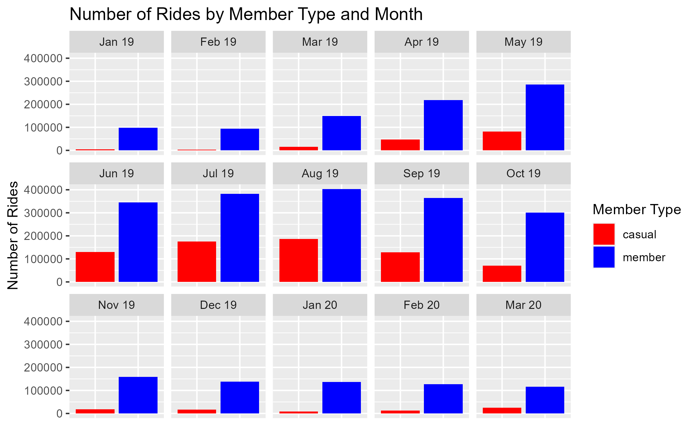
4A - Members use the bikes more consistently year-round than non-members
Here we can observe the patterns for quantity of ride per month by Member Type:
While there is a drop in overall ridership during the months of inclement weather (fall/winter or Q1/Q4) it is evident that our Members continue to use the bikes year round while the casual member type has a significant drop off to almost nothing during the same time period.

Slide 13
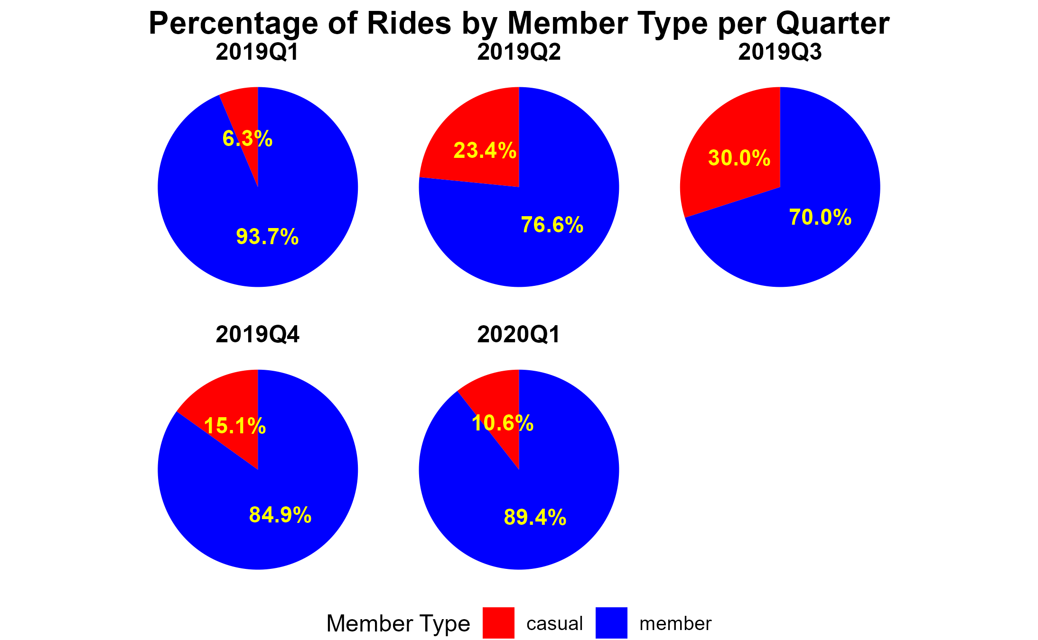
4B - Members use the bikes more consistently year-round than non-members
Here we can see a Quarter over Quarter view showing the percentage of rides by the type of Member.
The consistency of the Member vs. Casual member type percentage clearly shows the majority of all Cyclistic rides are with paid Members

Slide 14
Conclusions and Recap
Members use the bikes far more often
For the dataset time period, “Member” use accounts for just over 78% of all Cyclistic rides
During the months of inclement weather - considered as Q1 & Q4 annually “Member” use accounts for approximately 90% of all Cyclistic rides
"Members" use the bikes for shorter trips in comparison to "Casual"
Members use the bikes for the 5-10 minute timeframe the most with approximately 34% of all Member rides in this timeframe
The majority of Member trips are less than 15 minutes - approximately 72.5% of all member trips are 15min or less
The percentage of use between members and causal is consistent in a Quarter over Quarter review

Slide 15
Conclusions and Recap
Members use the bikes more often on weekdays than weekends:
Over 80% of all Member rides are during the weekdays (Monday to Friday)
The most common weekday AM start time = between 8-9am
The most common weekday PM start time = between 5-6pm
These Member start times are consistent year-round
There is a high probability that members are using the bikes as part of their commute to work, however this would require more analysis to confirm.
Members use the bikes more consistently year-round than non-members:
While there is a drop in the quantity of overall riders during the months of inclement weather (fall/winter or Q1/Q4) it is evident that our Members continue to use the bikes year round while the casual member type has a significant drop off to almost nothing during the same time period.
Members account for the following percentage of all rides
Q1 = 89%+
Q2 = 75%+
Q3 = 70%+
Q4 = 84%+

Slide 16
Takeaways & Suggestions
In order to improve future data analysis for the usage of Cyclistic bikes I would suggest the following metrics be added/tracked as best possible moving forward to improve the accuracy and relevancy of the data. This can be done through customer surveys/polls or obtained through other data collection sources (i.e. 3rd party data) and could greatly help determine future business and marketing needs.
Customer gender
Is one gender using the bikes more often and why?
Is bike design causing any physical hinderance for use?
Customer age or age range
are the bike's being used by a specific age group?
Trip purpose - organized into 3 or 4 categories to standardize answers
i.e. - commute, entertainment (sight seeing/tourism), work(delivery/collection), exercise
Better start & stop station identification
a physical address would work better than Lat & long for mapping travel habits of both Member and Casual user as it will be more compatible with mapping software.
This could also help determine where best to distribute the bikes based on usage or where to increase the bike quantity for better availability/profitability

Slide 17
THANK YOU

Slide 18
R (base R): R Core Team (2024). _R: A Language and Environment for Statistical Computing_. R Foundation for Statistical Computing, Vienna, Austria. https://www.R-project.org/.
RStudio Desktop (software): RStudio 2024.04.2+764 "Chocolate Cosmos" Release (e4392fc9ddc21961fd1d0efd47484b43f07a4177, 2024-06-05) for windows Mozilla/5.0 (Windows NT 10.0; Win64; x64) AppleWebKit/537.36 (KHTML, like Gecko) Studio/2024.04.2+764 Chrome/120.0.6099.291 Electron/28.3.1 Safari/537.36, Quarto 1.4.555
R Package "tidyverse": Wickham H, Averick M, Bryan J, Chang W, McGowan LD, François R, Grolemund G, Hayes A, Henry L, Hester J, Kuhn M, Pedersen TL, Miller E, Bache SM, Müller K, Ooms J, Robinson D, Seidel DP, Spinu V, Takahashi K, Vaughan D, Wilke C, Woo K, Yutani H (2019). “Welcome to the tidyverse.” _Journal of Open Source Software_, *4*(43), 1686. doi:10.21105/joss.01686.
R Package "conflicted": Wickham H (2023). _conflicted: An Alternative Conflict Resolution Strategy_. R package version 1.2.0, https://CRAN.R-project.org/package=conflicted.
R Package "dplyr": Wickham H, François R, Henry L, Müller K, Vaughan D (2023). _dplyr: A Grammar of Data Manipulation_. R package version 1.1.4, https://CRAN.R-project.org/package=dplyr.
R Package "ggplot2": H. Wickham. ggplot2: Elegant Graphics for Data Analysis. Springer-Verlag New York, 2016. https://ggplot2.tidyverse.org
R Package "lubridate": Garrett Grolemund, Hadley Wickham (2011). Dates and Times Made Easy with lubridate. Journal of Statistical Software, 40(3), 1-25. https://www.jstatsoft.org/v40/i03/.
R Package "tidyr": Wickham H, Vaughan D, Girlich M (2024). _tidyr: Tidy Messy Data_. R package version 1.3.1, https://CRAN.R-project.org/package=tidyr.
R Package "scales": Wickham H, Pedersen T, Seidel D (2023). _scales: Scale Functions for Visualization_. R package version 1.3.0, https://CRAN.R-project.org/package=scales.
R, RStudio desktop and installed packages information and licensing

